Slide 1
Enhancing County and Provider Contract Discussions
November 15, 2023

Slide 2
Learning Goals
Create a collaborative environment for financial planning and contracting.
Discuss NBP&B timelines incorporating IV-E and Act 148.
Understand the challenges from all perspectives.
Learn how data can play an important role.
Provide technical support and information to providers and counties for NBP&B and IV-E processes.

Slide 3
Challenges and Lessons Learned
Providers have been unclear when providing documentation to counties for increased costs.
Cost of Living Increase (COLA).
Programmatic enhancements/unexpected costs.
Increasing cost of doing business.
Expanding cost of retaining and/or hiring employees.
Projecting budget information accordingly.
IV-E and NBP&B are both part of the overall process of budgeting and contracting.
The second iteration of RMTF brought more attention to the role of NBP&B in the process – for both counties and providers.

Slide 4
Challenges and Lessons Learned
Federal/State Participation Level versus Contract Rates.
Allowability.
Affordability.
Reasonableness.
Providing detailed supporting documentation to justify budget projections.
Overall financial health.

Slide 5
Challenges and Lessons Learned
The request for rate increases and accompanying financial information from providers did not always align with the county's process to project increases in NBP&B allotment.
Providers submit Placement Services Budget documentation (Act 148/Title IV-E budgets) between March 1 – April 15 to allow for counties to incorporate NBP&B projections.
Providers are not utilizing the Provider Needs Based Plan &Budget Tool (Budget Tool) consistently among counties creating a challenge to obtain additional information to support the request for rate increases.

Slide 6
Challenges and Lessons Learned
Providers are not forecasting rate increases needed for the programs.
Enhances open dialogue with county partners regarding true cost of care.
Some counties have encouraged providers to utilize the Provider NPB&B Budget Tool to streamline the process.
Utilizing the tool assists the counties decrease amount of supporting documents to justify NBP&B.

Slide 7
Challenges and Lessons Learned
Utilizing the tool deceases the amount of time a provider and county spend on follow-up conversations.
Counties have incorporated the information within an overall narrative and/or cover letter within the NBP&B.
Development of a summary of the provider’s tool to submit along with NBP&B assists OCYF approval of county requests.
Approved increase requests should be utilized as intended.
OCYF will accept a county’s submission of Provider Request for NBP&B tool along with NBP&B to be used as justification documents.
As challenges arise, communication is vital.

Slide 8
Timeline
April 1, 2024
Provider sends needs to the county for FY25/26
April - July 2024
Counties and providers negotiate FY24/25 rates (based on prior budget submission/participation levels)
August - September 2024
County submits the FY 25/26 NBP&B (with provider's needs which were communicated in March)
Feb-March 2025
State communicates tentative determinations to County. This is not a guarantee of requested increases! Rate contracts will have to occur for the upcoming July.
June 2025
Rate negotiations based on prior year submissions- (County makes changes based on needs to their implementation year budget)
Provider establishes a budget projection for 1.5 years in the future – FY 25/26
Jan.–March 2024
March 1 - April 15, 2024
Provider submits for Federal/State Participation Levels to the state based on actual and budgeted projections for FY 24/25
Provider builds projections/needs into their FY 25/26 Budget Documentation (148/IV-E) submission – due March 1,-April 15 2025

Slide 9
Benefits and Enhancements to Process Identified Since 2020
Accurately budgeting for fiscal health.
Robust and stabilized environment for child welfare and juvenile justice services.
NBP&B –Provider NBP&B Budget Tool for Placement & Community-Based services (optional).
Clear rationale for increases using data.
How data and reasonableness intersect.
Ongoing technical assistance.
Enhanced communication with partners.

Slide 10
Benefits and Enhancements to Process Identified Since 2020
Counties requests through NBP&B received increases based on additional justification submitted by providers.
Decreased request for counties to submit additional documentation during NBP&B process to support increase in NBP&B.
Providers were granted increases requested.
Providers were able to enhance technical needs to accommodate challenges created by the pandemic.
Providers were able to increase starting and current wages for employees.
Increased utilization of the Provider Request for NBP&B inclusion tool.

Slide 11
Benefits and Enhancements to Process Identified Since 2020
Providers Placement Services Budget documentation (Act 148/Title IV-E budgets) submission rate increased 32.06% of providers submitting between March 1 – April 15 since FY2020/21.
The timeframe of Budget documentation from initial submission to the Quality Assurance review phase decreased by 13.38% since FY2020/21.
Timeframe of Budget documentation completed within required timeframe has maintained a 90% average.
PA Statewide Standardized Time Study process was implemented January 2021. The process assists providers report staff job category percentages for the next budget reporting period more accurately.

Slide 12
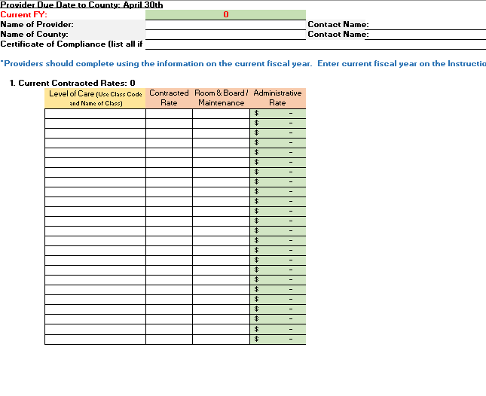
Enhancements to Process Continued
Provider NBP&B Budget Tool was created.
The Budget Tool is accepted by OCYF as an attachment to the NBP&B to support the county's justification.
The Budget Tool incorporates Community-Based Services.
A detailed training is available to identify tool utilization.

Slide 13
Healthy Child Welfare System
Sustainable Financial Process
Commitment to Collaboration
An opportunity for PA to increase outcomes and better serve youth and families
Quality Services
CQI – Monitoring and Improvement
Why we do what we do

Slide 14
Additional Items to Consider
As a provider, have you incorporated detailed information to the county to support requests?
As a county, are you receiving the detailed information you require?
As a county, if you are not receiving the detailed information, what are the next steps?
As a county, was the Provider NBP&B Budget Tool and/or summary incorporated into the NBP&B?
Was your NBP&B request approved by the state?

Slide 15
Additional Items to Consider
What questions do you have that were not addressed today?
Additional resources/trainings and the Provider NBP&B Budget Tool can be accessed here.
Rate Methodology Task Force Recommendations 2019 can be accessed here.
Additional county questions are to be directed to bbornman@pacounties.org.
Additional provider questions are to be directed to HbgOffice@pccyfs.org.

Slide 16
Q&A Session

Slide 17
Group Members
Brian Bornman, PCYA
Terry Clark, PCCYFS
Dave Mattern, PCCYFS
Sandy Shedlock, PCG
Dr. Craig Adamson, CSF/Buxmont Academy
Elaine Kita, Northampton County CYA
Andy Benner, Cumberland County JPO
Stephanie Devilbiss, The Bair Foundation
Nancy Kukovich, Adelphoi
Michelle Fronheiser, Bucks County CYA
Stephen Samaan, Berks County CYA
Gretchen Garrity, OCYF
Tia Petrovitz, OCYF
Melissa Erazo, OCYF

